Slide 1
APPLIED DATA SCIENCE PROJECT
Presentation: by Team 4

Slide 2
Team Members
PARTHIBAN SETHURAMAN
JASMON HOH WAN TING
TEAM 4
CHING WAI MAN RATSEY
YESEY TENG DU SZE

Slide 3




Project Requirements
KEY TASK
1
KEY TASK
2
KEY TASK
3
KEY TASK
4
Determine
business
objectives
Data
Collection
and
Exploration
Data
Transformation
Modelling
and
Evaluation

Slide 4
Business Understanding
Scenario Background:
The dataset, obtained from Kaggle, related to conversion record of inquirers for enrolling course in X Education, an institution offering a diverse range of courses including financial management, e-commerce, business administration, healthcare, IT project managements, service excellence and other courses.
The dataset encompasses a comprehensive overview of inquirers, including their demographics, online behavior, lead sources, asymmetrical information, and most crucially, their conversion status - whether they ultimately enrolled in a course.
Data Mining:
Analyse the dataset and provides insights into which may reveal hidden patterns influencing enrollment decisions through:
Clustering
Regression Model
Text Analytics
Decision Tree

Slide 5
Business Goal & Objectives
To analyse the factors influencing conversion success
To identify the factors that can increase time spent on website
Business Goal:
Increasing conversion
rate
To understand strengths and weaknesses of the institution
To analyse effectiveness of marketing strategies

Slide 6
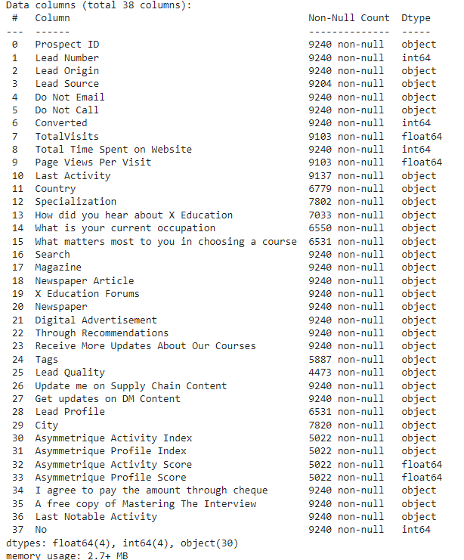
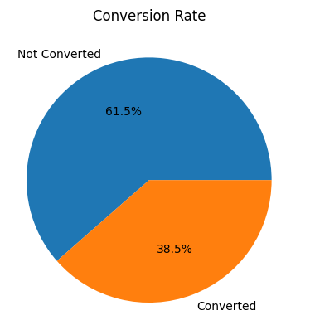
Data Understanding
Data Collection Sources:
Kaggle
Data Fields Description:
There are total 38 variables and 9,240 rows.
The variables are as per table below.

Slide 7
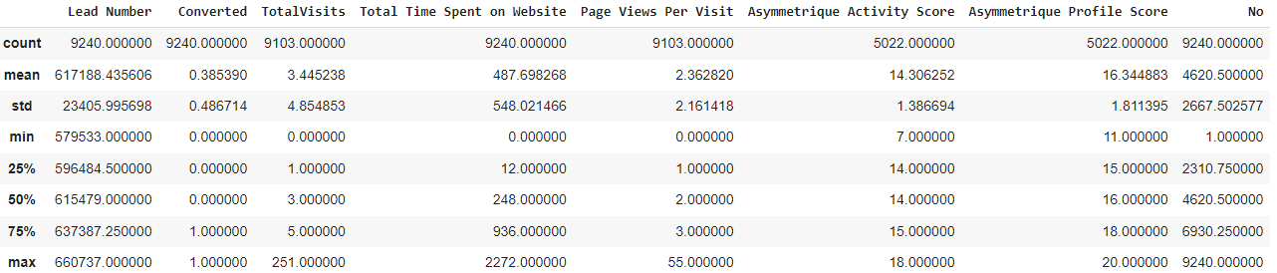
Data Understanding
Data Exploration:
Data Quality:
We have identified missing values in several variables within the dataset. To ensure the accuracy and reliability of our analysis, it is essential to address these gaps and also perform data cleaning.

Slide 8
Data Preparation
Following cleaning steps had been carried out through Python:
Imputation for missing values in the data set
Drop the irrelevant data
Converting the data type
Categorical data
Handle the outlier
By performing these data cleaning steps, we aim to enhance the overall quality and completeness of the dataset. This will lead to more accurate analyses and insights, ultimately supporting more informed decision-making.

Slide 9
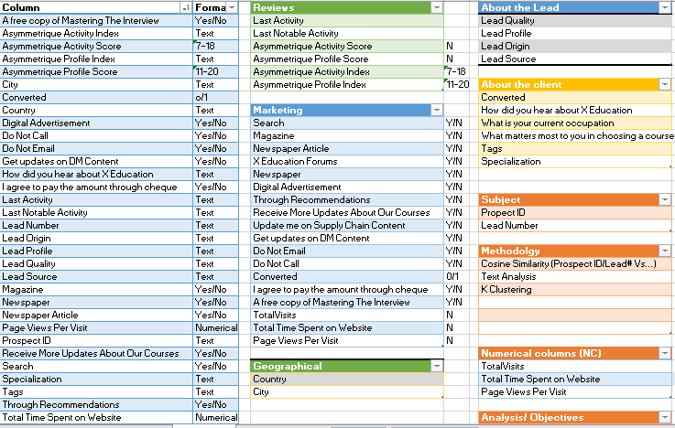
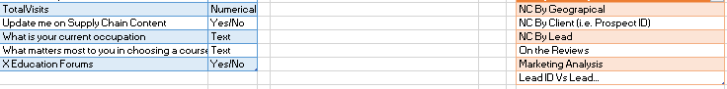
Columns of the dataset- an overview

Slide 10
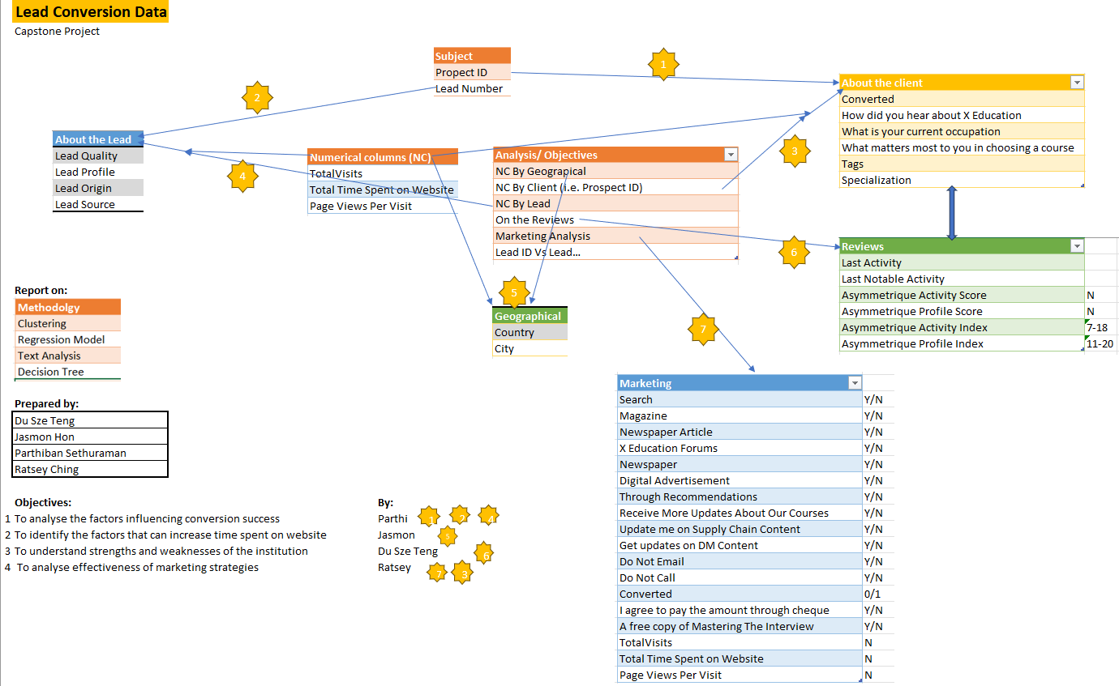
Relationship of columns of the dataset

Slide 11
Methodologies
Analytical Approaches:
Clustering
Regression Model
Text Analytics
Random Forest
Ensemble Method
Algorithms Used
Model Selection and Rationale
Python modules and Libraries Used
Pandas, numpy, statsmodels, pylab, scipy, matplotlib, sklearn

Slide 12
Results and key findings

Slide 13
Biz Objective 1
by
Parthiban Sethuraman

Slide 14
Biz Objective 1
Objective: To analyze the behaviors of candidates landing on various online platforms, an institution that markets courses on multiple websites examines the factors influencing potential candidate conversion success.
Dependent / Target Variable: Converted (0/1): Indicates whether the lead was successfully converted (1) or not (0).
Objectives Breakdown
Determine the contribution of final independent variables to the likelihood of conversion.
Compare the coefficients of these variables to understand their relative impact.
Provide a summary of findings with recommendations for improvement in generation and conversion strategies.
Independent Variable: Remaining variables after dropped / imputed. (Refer Slide 26)

Slide 15
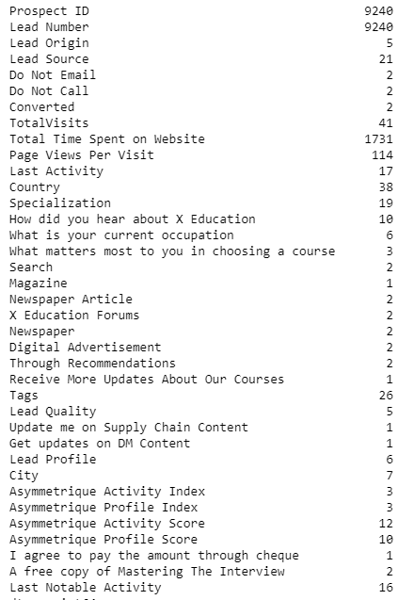
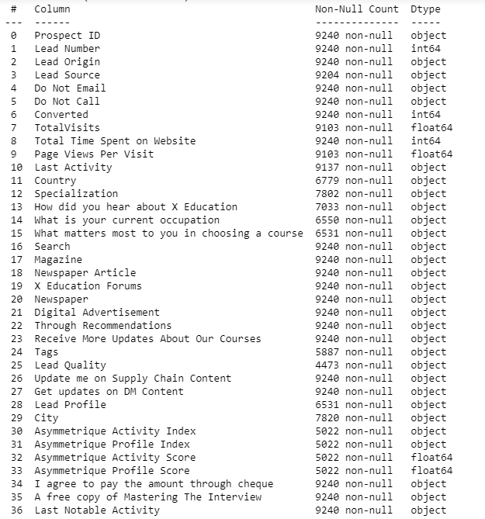
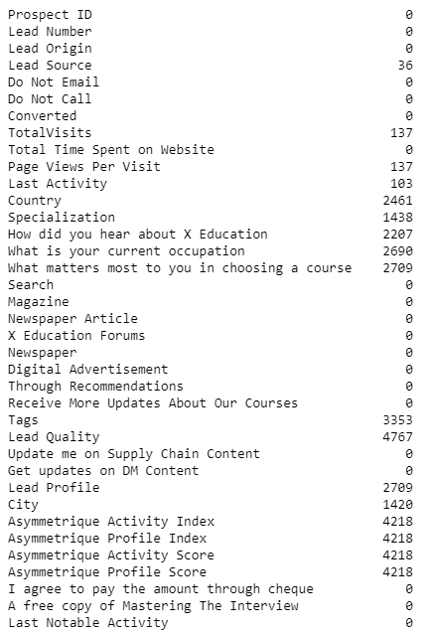
Biz Objective 1
Data Understanding
Data has certain categorical and numerical values which help in contributing to the dependent variable. Below is the understanding of unique values in each field and their data types and NULL values if any.
UNIQUE
DATA TYPES
NULL VALUES
There are null values in the dataset and no duplicates of data.

Slide 16
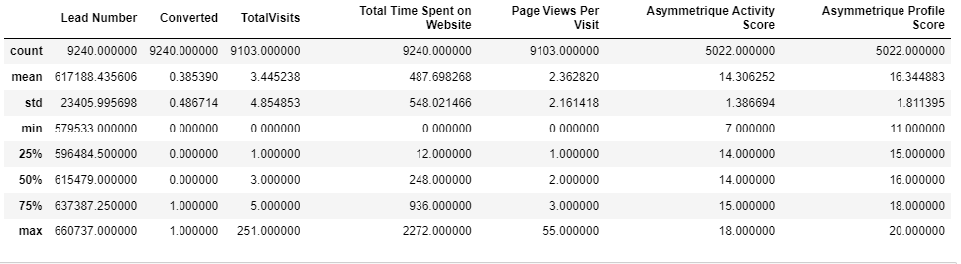
Biz Objective 1
Data Understanding
Data understanding of numerical fields within the dataset such as total time spent on website and asymmetrique profile score. These fields and their min, max, mean values helps in understanding the data better in terms of minimum and maximum visits to websites and activity levels of candidates.

Slide 17
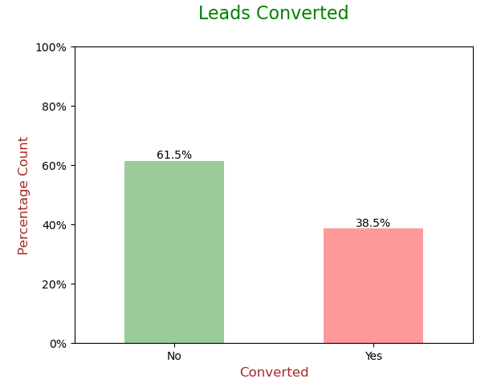
Biz Objective 1
Data Understanding - Imbalance Analysis
Data is imbalance when one value is present in majority and other is in minority meaning an uneven distribution of observations in dataset
Data imbalance is in the context of Target variable only
Target variable is 'Converted' which tells whether a past lead was converted or not wherein 1 means it was converted and 0 means it wasn’t converted

Slide 18
Biz Objective 1
Data Cleaning Steps:
Determine and handle missing values for numeric columns and Imputation
Analyse Categorical columns for missing values and skewness
Removing unwanted columns or columns that does not contribute to the model.
Analyse Outliers
Univariate Analysis

Slide 19
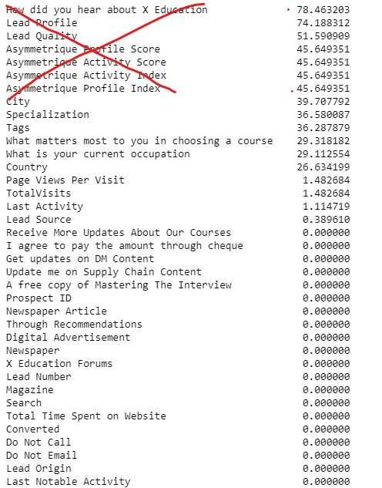
Biz Objective 1
Data Cleaning - Determine and handle missing values for numerical columns and Imputation
Many Categorical column has the value ‘select’ (as the candidate did not select any option) which needs to be handled as its treated as a null value. - Specialization, How did you hear about X Education, Lead Profile, City
Numerical columns that has missing values: total visits has been imputed using mode.
Page views per visit: Imputed using mode
Columns with more than 40% missing values are dropped.

Slide 20
Biz Objective 1
Data Cleaning - Analyse Categorical columns for missing values and skewness
“City” has 39.71 % missing values. Imputing missing values with Mumbai will make the data more skewed. Skewness will later cause bias in the model. Hence City column can be dropped.
“Specialization” has 36.58 % missing values. The specialization selected is evenly distributed. Hence imputation or dropping is not a good choice. We need to create additional category called 'Others'.
”Tags” has 36.29 % missing values. Tags are assigned to customers indicating the current status of the lead. Since this is current status, this column will not be useful for modeling. Hence it can be dropped.
“What matters most to you in choosing a course” This variable has 29.32 % missing values. 99.95% customers have selected 'better career prospects'. This is massively skewed and will not provide any insight.
“What is your current occupation”: We can impute the missing values with 'Unemployed' as it has the most values. This seems to be a important variable from business context, since X Education sells online courses and unemployed people might take this course to increase their chances of getting employed.
“Country”: X Education sells online courses and appx 96% of the customers are from India. Does not make business sense right now to impute missing values with India. Hence `Country column can be dropped.
“Last Activity”: "Email Opened" is having highest number of values and overall missing values in this column is just 1.11%, hence we will impute the missing values with label 'Email Opened'.
“Lead Source”: "Google" is having highest number of occurences and overall nulls in this column is just 0.39%, hence we will impute the missing values with label 'Google'
Dropping the following categorical columns
'City',
'Tags',
'Country',
'What matters most to you in choosing a course'

Slide 21
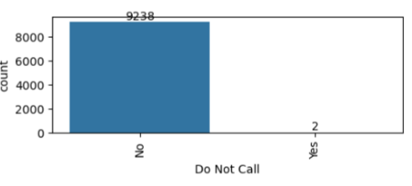
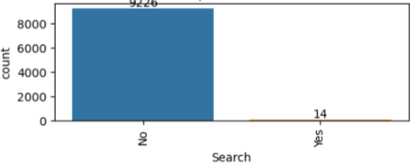
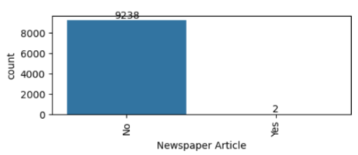
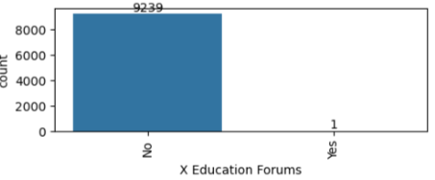
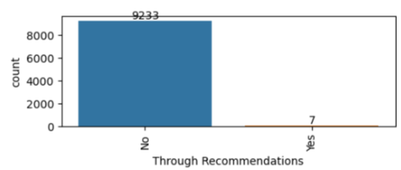
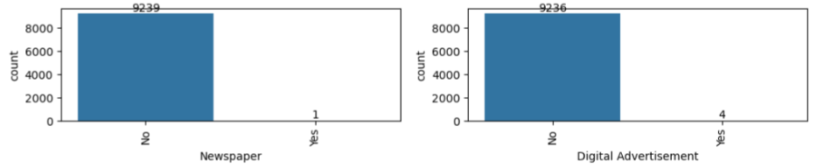
Biz Objective 1
Highly Skewed columns - dropped and not added to model.

Slide 22
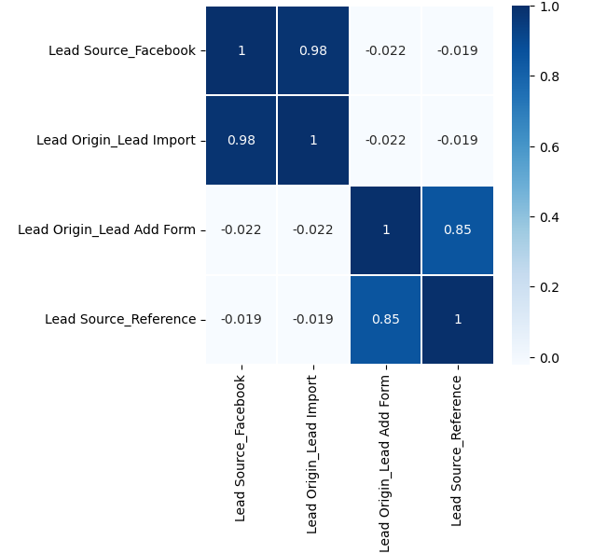
Biz Objective 1
Data Cleaning - Unwanted columns or columns that does not contribute to the model.
Following columns has only 1 value and does not add any value to the model and these will be dropped
'I agree to pay the amount through cheque',
'Get updates on DM Content',
'Update me on Supply Chain Content',
'Receive More Updates About Our Courses',
'Magazine'
'Prospect ID',
'Lead Number',
'Last Notable Activity'
The predictor variables mentioned above are highly correlated with each other, with correlation coefficients of 0.98 and 0.85. Therefore, it is advisable to drop one variable from each pair, as they won't add significant value to the model. Consequently, we can drop 'Lead Origin_Lead Import' and 'Lead Origin_Lead Add Form'.

Slide 23
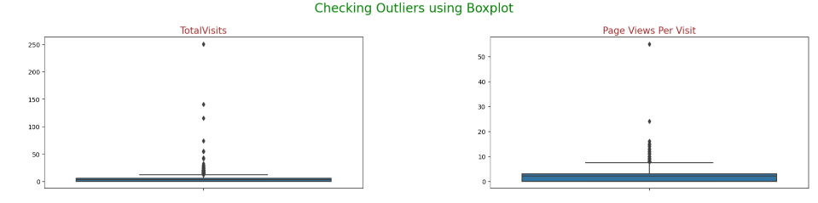
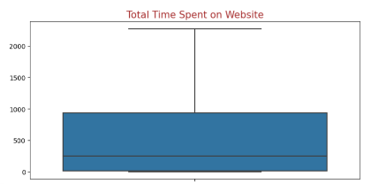
Biz Objective 1
Data Cleaning - Analyse Outliers
Outliers present in columns: Total Visit, Page View per visit, total time spent on website - This is handled using The function Outlier_treatment is designed to treat outliers in specified columns of a DataFrame by capping and flooring values based on the Interquartile Range (IQR) method.

Slide 24
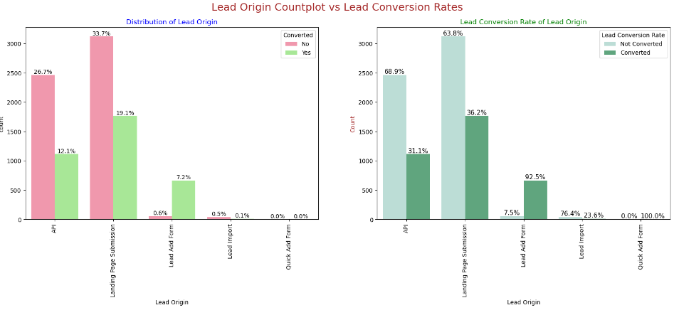
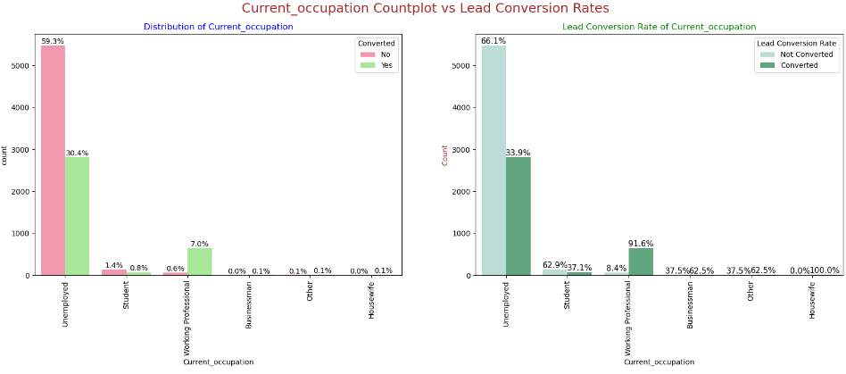
Biz Objective 1
Data Cleaning - Univariate
Lead Origin: Around 52% of all leads originated from "Landing Page Submission" with a lead conversion rate (LCR) of 36%.The "API" identified approximately 39% of customers with a lead conversion rate (LCR) of 31%.
Current_occupation: Around 90% of the customers are Unemployed with lead conversion rate (LCR) of 34%. While Working Professional contribute only 7.6% of total customers with almost 92% lead conversion rate (LCR).

Slide 25
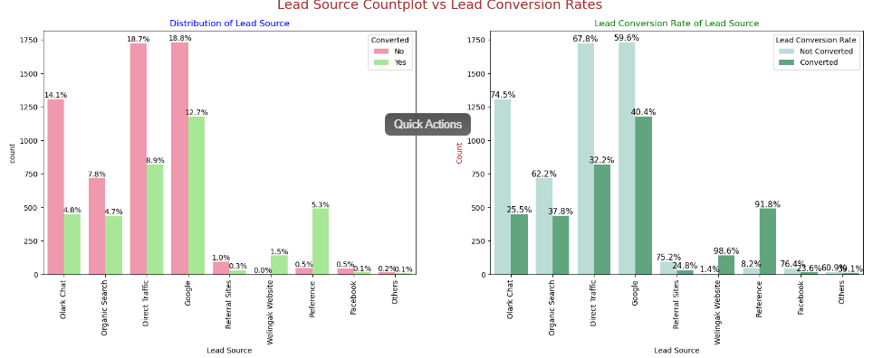
Biz Objective 1
Data Cleaning - Univariate Analysis
Lead Source: Google has LCR of 40% out of 31% customers , Direct Traffic contributes 32% LCR with 27% customers which is lower than Google,Organic Search also gives 37.8% of LCR but the contribution is by only 12.5% of customers ,Reference has LCR of 91% but there are only around 6% of customers through this Lead Source.

Slide 26
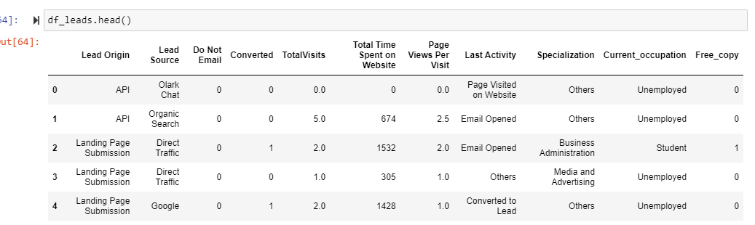
Independent Variable (Shortlisted)
Data Preparation: Dummy Variables
Creating dummy variables for categorical variables and dropping the first category is a common practice to avoid multicollinearity, especially when using linear models. This process involves converting each category of a categorical variable into a separate binary column (dummy variable) and then removing one of these columns to serve as a baseline.

Slide 27
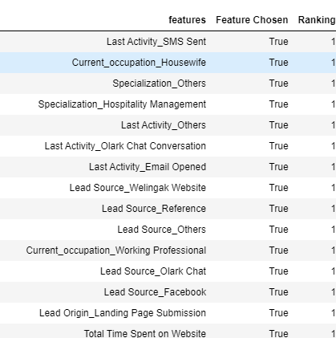
Feature Selection
Feature Selection is done using RFE (Recursive Feature Elimination).
This is the estimator/model used by RFE to evaluate the importance of features. In this case, it's the LogisticRegression model.
No of features to select is 15 and the final list of features is as below after the RFE method.

Slide 28
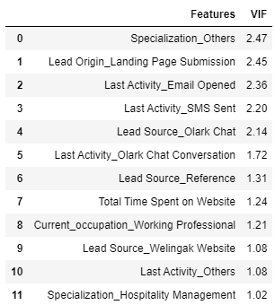
Model Building - Logistic Regression
The selected features from RFE method is fitted into Logistic regression and the model parameters are considered to drop certain variables which has high p-value
The following variables are dropped as they have a high p-value. After 3 models the final list of attributes with stable p value <0.05 and VIF

Slide 29
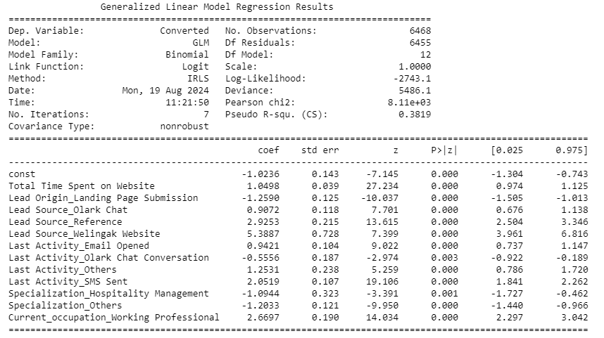
Model Evaluation - Logistic Regression

Slide 30
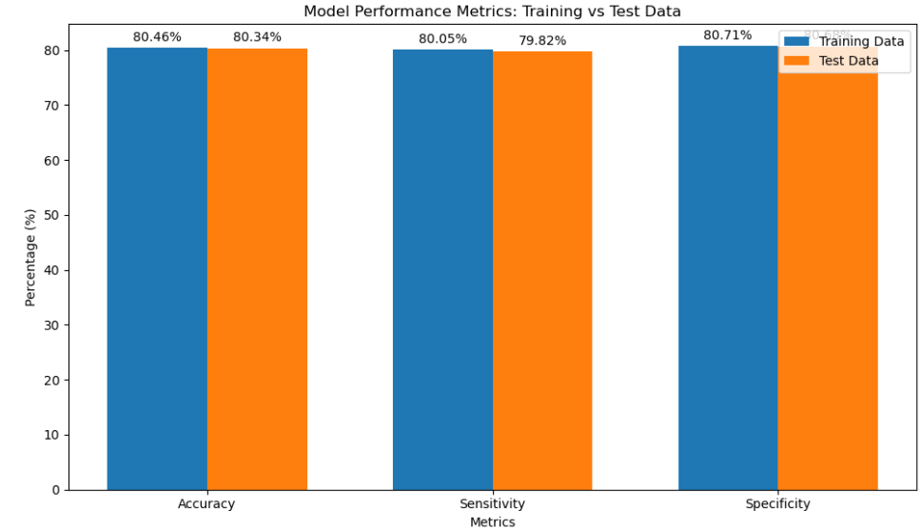
Train Data Set:
Accuracy: 80.46%
Sensitivity: 80.05%
Specificity: 80.71%
Test Data Set:
Accuracy: 80.34%
Sensitivity: 79.82% ≈ 80%
Specificity: 80.68%
The evaluation matrics are pretty close to each other so it indicates that the model is performing consistently across different evaluation metrics in both test and train dataset.
The model achieved a sensitivity of 80.05% in the train set and 79.82% in the test set, using a cut-off value of 0.345.
Sensitivity in this case indicates how many leads the model identify correctly out of all potential leads which are converting
The model also achieved an accuracy of 80.46%, which is in line with the study's objectives.`

Slide 31
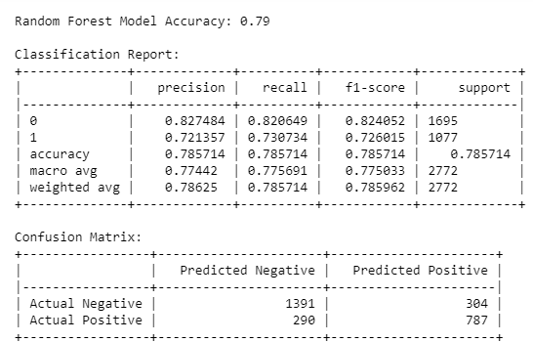
Model Building & Evaluation - Random Forest
The same shortlisted features from logistic regression modelling using RFE and optimal p value is trained using random forest model. Better performance is observed with random forest.

Slide 32
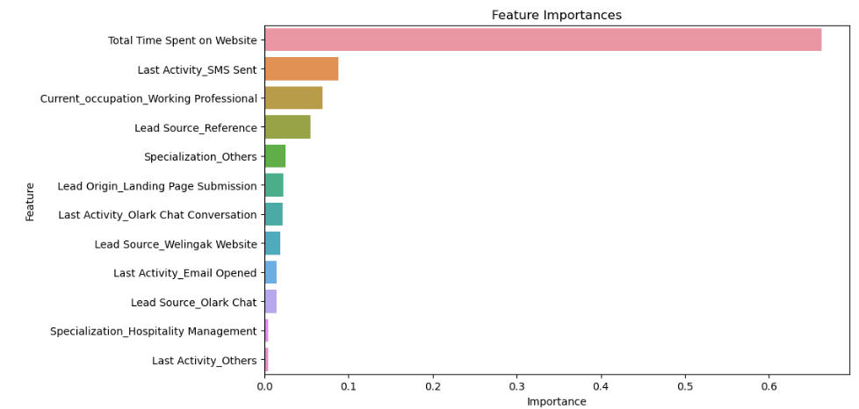
Feature Importance - Random Forest
Feature importance provides insight into which features are most influential in making predictions.
Tree-based models (Random Forest, Gradient Boosting) provide direct feature importance scores based on impurity reduction.

Slide 33
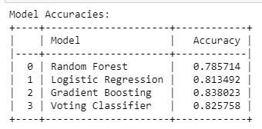
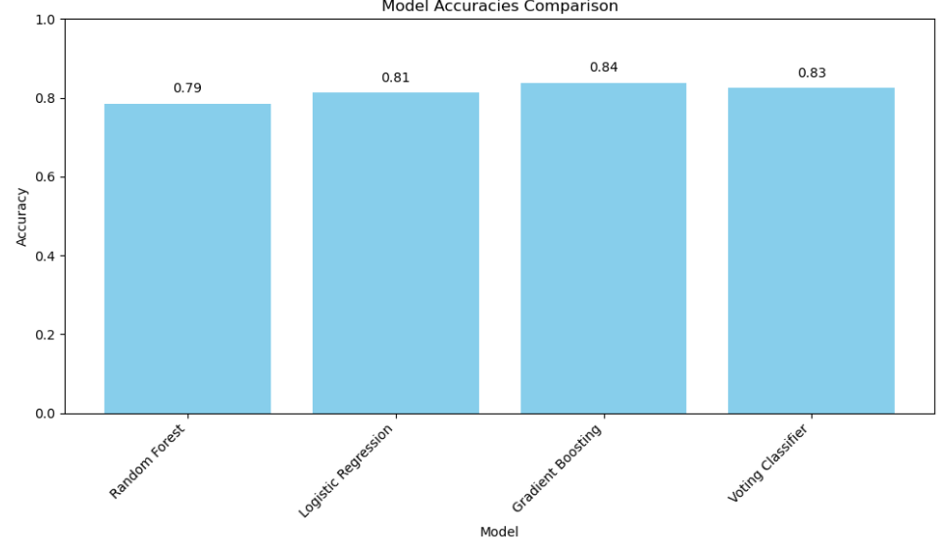
Model Building & Evaluation - Ensemble Method
Weak Learners - Random forest, logistic regression, Gradient boosting classifier. Individual models are trained on the shortlisted features and finally a voting classifier is used with a soft voting which averages the probabilities of each class predicted by the models.
Benefits:
The ensemble model combines a Random Forest, Logistic Regression, and Gradient Boosting model using soft voting. Each model contributes to the final prediction based on its confidence in its predictions. This approach often results in a more accurate and robust model, leveraging the strengths of each base learner.

Slide 34
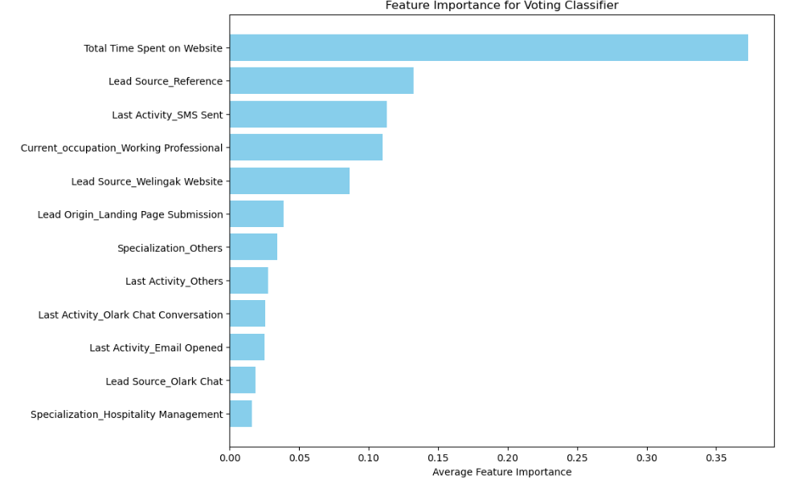
Feature Importance - Ensemble Method
Total Time Spent on Website: A high importance score suggests this feature is crucial for predicting outcomes, likely because more time spent indicates higher engagement or interest.
Lead Source_Reference: The importance of this feature might indicate that referrals have a strong impact on conversion rates.

Slide 35
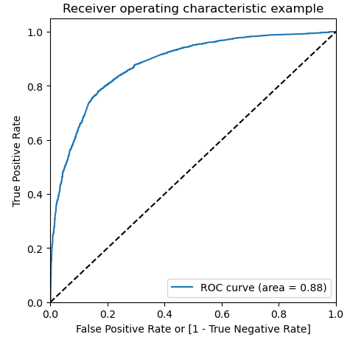
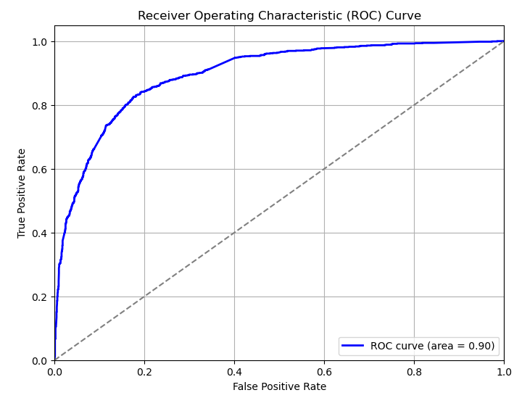
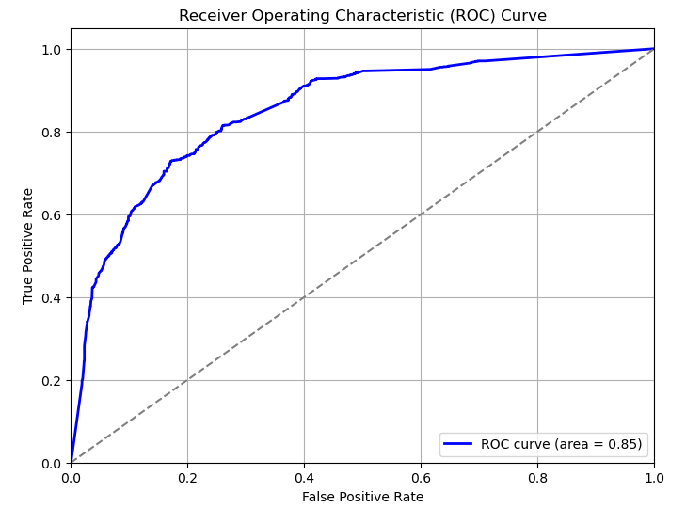
ROC comparison
Logistic Regression Random Forest Ensemble Method
The ROC curve comparison shows that while each model has its strengths, the ensemble method outperforms both Logistic Regression and Random Forest individually. This highlights the power of ensemble methods in machine learning, where the combination of different models often leads to better generalization and more robust performance on unseen data. The higher AUC of the ensemble method indicates its superior ability to distinguish between the classes, making it the preferred choice for this particular classification task.

Slide 36
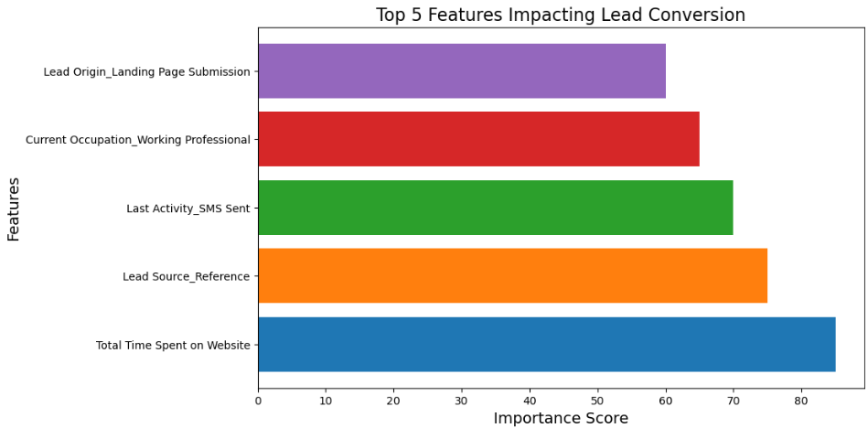
Findings and final recommendation
Top 5 Features Identified
Total Time Spent on Website
Lead Source_Reference
Last Activity_SMS Sent
Current Occupation_Working Professional
Lead Origin_Landing Page Submission

Slide 37
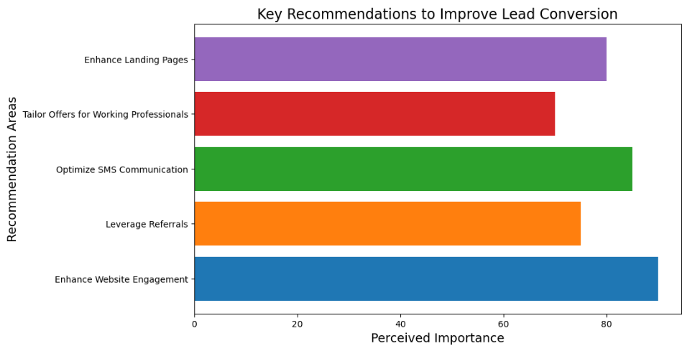
Findings and final recommendation
Recommendations to Improve Conversion
Enhance Website Engagement
Optimize Content: Ensure that website content is engaging, relevant, and valuable to encourage longer visits. Use interactive elements, videos, and high-quality information.
Improve User Experience: Simplify navigation, reduce page load times, and ensure that the website is mobile-friendly to increase time spent on the site.
Leverage Referrals
Referral Programs: Develop or enhance referral programs to incentivize existing customers to refer new leads. Offer rewards or discounts for successful referrals.
Build Partnerships: Collaborate with partners or influencers who can refer high-quality leads.
Optimize SMS Communication
Targeted SMS Campaigns: Use SMS for timely and personalized follow-ups. Ensure that messages are relevant and provide value to the recipient.
Automate SMS Notifications: Set up automated SMS notifications for key actions, such as abandoned carts or special offers.
Tailor Offers for Working Professionals
Customize Messaging: Create targeted marketing campaigns specifically for working professionals, highlighting features and benefits that cater to their needs.
Offer Flexible Solutions: Provide flexible payment plans or options that cater to the schedules and needs of working professionals.
Enhance Landing Pages
Optimize Forms: Simplify and optimize landing page forms to reduce friction and improve conversion rates. Use A/B testing to find the most effective form designs.
Personalize Content: Ensure that landing page content is relevant to the source of the lead and aligns with their interests or needs.

Slide 38
Biz Objective 2
by
Jasmon Hoh

Slide 39
Biz Objective 2
To identify the factors that can increase time spent on website
Firstly, the education institute believes that the more time customers spends on their website, the more likely they will convert and also spread the word to their friends and family, expanding the clientele and improving future conversion chances for them.
Secondly, the first analysis also showed that time spent on websites is one of the most important factor that affects the conversion rate. Therefore, I am looking into factors to increase time spent on website in support of the greater objective on increasing conversion rate, to drill down further.
To summarize: I am examining the factors that lead to more time being spent on the website, and as such they can spend more resources to target this group of people that is likely to lead to successful conversion

Slide 40
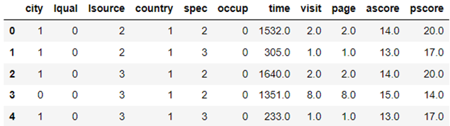
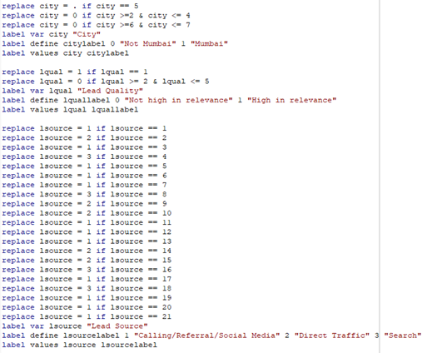
Biz Objective 2
Data Cleaning and Transformation:
Dependent Variable: Time spent on website (Continuous variable)
Final Independent Variables Simplification / Transformation (10 variables) :
Country (From 38 categories→ To Binary (India / Not India)
City (From 7 categories → To Binary (Mumbai / Not Mumbai)
Occupation (From 6 categories → To Binary (Working / Not working)
Specialization (From 19 categories → To 4 categories (Finance / Business / Marketing / HR)
Lead Quality (From 5 ordinal categories → To Binary (Highly relevant / Not or low relevance)
Lead Source (From 21 categories → To 3 categories (Social Media, Search Engine, Direct Traffic)
Asymmetrique Profile Score (Continuous variable)
Asymmetrique Activity Score (Continuous variable)
Total Page Views (Continuous variable)
Total Visits (Continuous variable)
I also changed to “NaN” for all the observations with “Select” as response
Rejected independent variables (as they are similar to the Profile/Activity Score)
Asymmetrique Profile Index (Ordinal variable)
Asymmetrique Activity Index (Ordinal variable)
Note: Asymmetrique is a digital marketing company that also scores profiles and leads based on their company’s proprietary formula

Slide 41
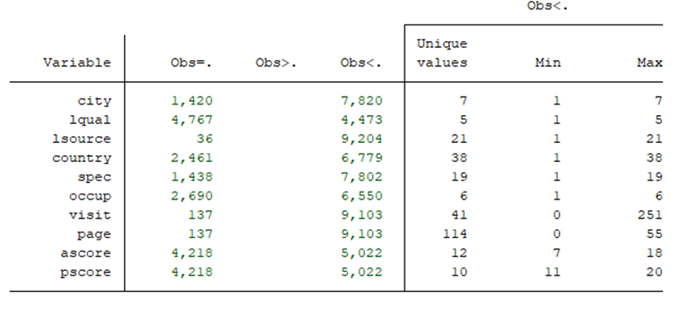
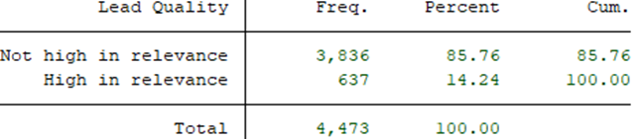
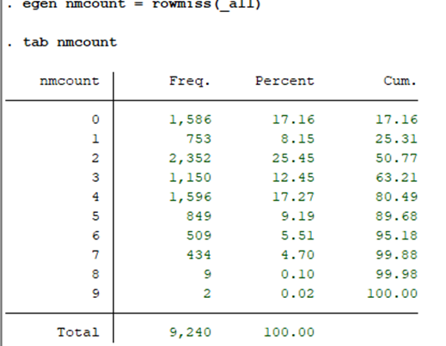
Biz Objective 2
Missing Values
Total number of observations is 9,240
All 10 of the selected independent variables has some missing values, ranging from 36 to 4,767
As the number of missing values is quite large for some variables (e.g. lead quality), and the distribution is quite skewed, it is not feasible to just use mode imputation either (e.g. Lead quality would then have been 8,603 (93%) vs 637 (7%))
I opted for listwise deletion instead, to at least capture data from respondents that have an answer for all the selected variables
As 1,586 observations did not have any missing variables, which is still sufficiently large, I chose that as my sample size
Final sample size = 1,586 observations

Slide 42
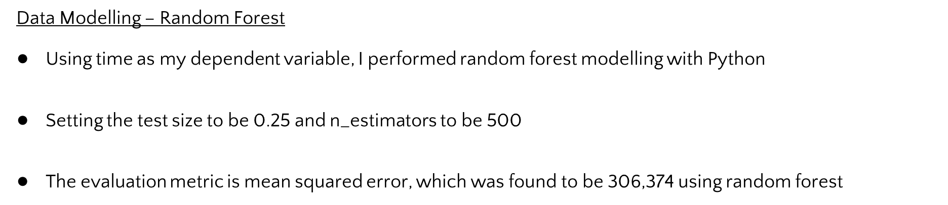
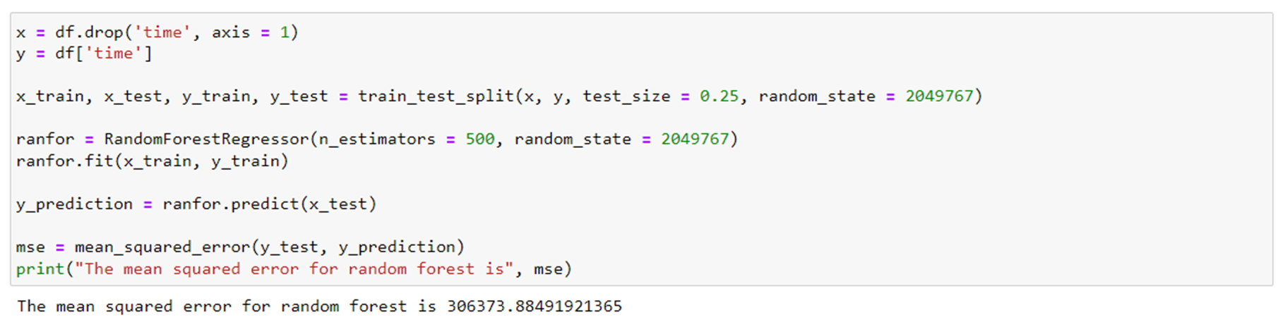
Biz Objective 2

Slide 43
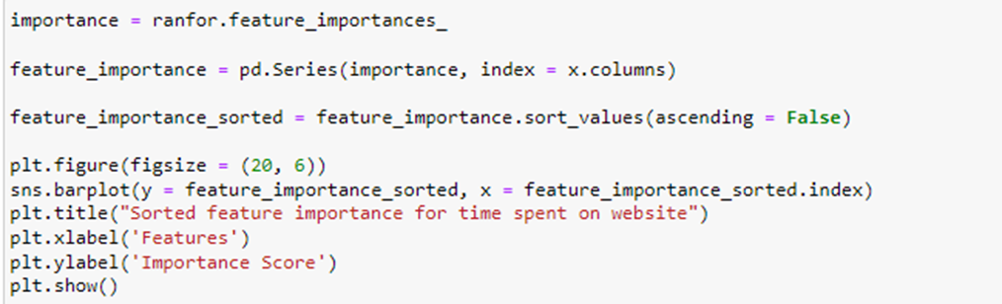
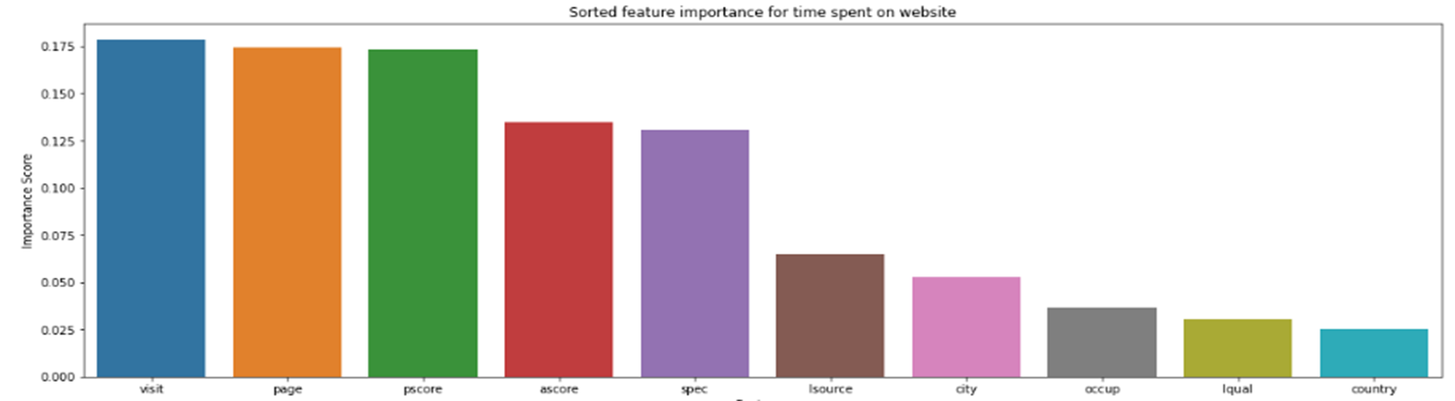
Biz Objective 2
Data Modelling – Random Forest
Based on feature importance, it was found that (1) total number of page visits, (2) total number of page views, (3) profile score has the highest importance scores;
while (1) country, (2) lead quality and (3) occupation had the lowest importance scores

Slide 44
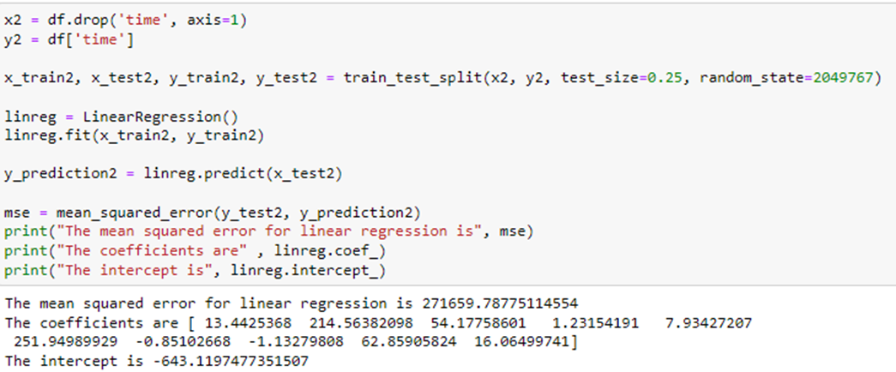
Biz Objective 2
Data Modelling – Linear Regression
To compare the performance of two models, linear regression is also used, with time spent on website as the dependent variable and all others as independent variables
The results showed that the mean squared error for linear regression is 271,660, which is lower than the MSE for Random Forest (306,374)
As such Linear Regression is chosen as the better model to be used.

Slide 45
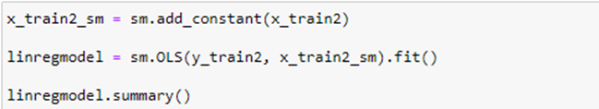


Biz Objective 2
Data Modelling – Linear Regression
Using StatModel, the coefficients that are statistically significant (95% CI) are clearly identified
In this case, the variables that significantly affect the time spent on website are Lead quality (lqual), Occupation (occup), and Activity score (ascore)
Better lead quality → More time spent
Working (instead of not working) → More time spent
Higher activity score → More time spent
As Linear Regression was chosen as the better model compared to Random Forest due to lower MSE, these are the 3 factors that are likely to affect time spent on website
As such, to increase the time spent on website (which could positively affect conversion rate), the education institute can target those that are already working, has higher activity scores, and tagged as better lead quality
Interestingly, both models also agree that the country and city are not important factors that affect time spent on the website.

Slide 46
Biz Objective 3

Slide 47
Biz Objective 3
To identify strengths and weaknesses for improving conversion rates through comment analysis
To gain a comprehensive understanding of inquirer and student sentiments, we will employ the text analytics capabilities of KNIME to conduct a thorough analysis of review/comments. This process will enable us to identify the institution's core strengths and weaknesses, serving as a foundation for developing strategies to optimize conversion rates.
By dissecting comments, we aim to uncover factors that positively influence enrollment decisions while simultaneously pinpointing areas of dissatisfaction that may impede conversion. Leveraging identified strengths as key selling points will allow X Education to enhance its market positioning and attract a larger student body. Conversely, addressing areas of improvement will contribute to increasing enrollment rates.

Slide 48


Biz Objective 3
Data Understanding
To gain a comprehensive understanding of the raw data, we employ KNIME's text analytics capabilities, which involve the sequential application of data import, text preprocessing, and visualization techniques.
Highlight
The feedback primarily relates to students, the school/college, courses, professors, staff, learning, and academic aspects. These common themes provide an overview of the reviews concerning X Education.
In the next step, we will perform data cleaning to eliminate frequently occurring common words. This will help us obtain a clearer, more focused picture of the feedback and uncover more specific insights.

Slide 49

Biz Objective 3
Data Selection and Cleansing:
The goal of this text processing pipeline is to extract key terms from text data by removing unnecessary elements by using the following nodes in KNIME:
Case Converter
Punctuation Eraser
Replacer
Stop Word filter, including custom list for common words
Porter Stemmer
Group by
Row Filter
With this data clearing, this helps to focus on the core words rather than the grammatical structure.

Slide 50

Biz Objective 3
Data Selection and Cleansing:
Following data cleansing, we observe that the review/comments are predominantly positive. Key highlights include:
Opportunities: Positive remarks about enhanced career prospects.
Appreciation for the helpfulness, skills and knowledge of staff/professors.
Highly recommend
However, there is also a notable concern regarding:
Expensive School Fees: dissatisfaction with the cost of tuition.
This balanced view will help us leverage strengths while addressing the concern about fees.

Slide 51

Biz Objective 3
Data Selection and Cleansing:
Following data cleansing, we observe that the review/comments are predominantly positive. Key highlights include:
Opportunities: Positive remarks about enhanced career prospects.
Appreciation for the helpfulness, skills and knowledge of staff/professors.
Highly recommend
However, there is also a notable concern regarding:
Expensive School Fees: dissatisfaction with the cost of tuition.
This balanced view will help us leverage strengths while addressing the concern about fees.

Slide 52

Biz Objective 3

Slide 53

Biz Objective 3

Slide 54

Biz Objective 3

Slide 55


Biz Objective 3

Slide 56


Biz Objective 3

Slide 57





Biz Objective 3

Slide 58




Biz Objective 3

Slide 59


Biz Objective 3

Slide 60


Biz Objective 3

Slide 61

Biz Objective 3
Conclusion:
X Education has received positive feedback for its experienced professors and supportive staff. These are key strengths that contribute to a positive learning experience for students. To attract more students, the school should highlight the expertise and unique teaching methods of the professors.
However, high tuition fees have been identified as a potential concern. To address this, X Education should conduct a thorough review of its fees and compare them to industry standards. This will help ensure that the fees are reasonable and competitive.
Additionally, implementing promotions such as early bird discounts or group discounts can make the school's offerings more attractive to potential students, especially those who may be budget-conscious. By focusing on these areas, X Education can continue to provide a high-quality education while also increasing enrollment.
While 72.5% of text reviews are positive, and only 27.5% are negative whereas the conversion rate of 38.5% is lower than expected. This may indicates a potential gap between customer satisfaction and actual purchasing behavior or the data bias due to limited dataset.
Although the overall positive sentiment is encouraging, the analysis is based on a limited dataset of reviews. To gain a more accurate understanding of customer sentiment, it is essential to analyze a larger volume of feedback using a trained model capable of handling a wider range of expressions and nuances.

Slide 62
Biz Objective 4

Slide 63

Biz Objective 4
To analyse the effective of marketing strategies in marketing using clustering to reduce the dimensions and then predict the convert results
Overview of the datasets

Slide 64
Biz Objective 4
Dependent Variable: ‘Converted’,
● Independent Variables Selected:
Marketing oriented columns consists of a group of numerical data columns and another group of Boolean columns. Model 1 built on Regression Model of ‘Converted’ Vs. the numerical columns and Model 2 built on Regression Model of ‘Converted’ Vs. the Boolean columns, ‘Total time spent on Websites’, ‘TotalVisits’, ‘Page Views Per Visit’ in order to establish prediction models from these features
About the Clients: ‘How did you hear about X Education’, ‘What is your current occupation’, ‘What matters most to you in choosing a course’, ‘Tags’ & ‘Specification’. The columns with Yes/No inputs to conduct the Regression Analysis and the ‘Tags’ & ‘Specification’ consists of preset options to allow to convert to dummies variables and in turn to conduct the k Logistic Regression Model
Demographic, ‘Country’ and ‘City’, focusing on the opportunities on extending market growth beyond Mummai and India
Reviews: columns with structural data ('Asymmetrique Activity Score', 'Asymmetrique Profile Score', 'Asymmetrique Activity Index', 'Asymmetrique Profile Index’) and unsupervised data (‘Tags’ and ‘What matters most to you in choosing a course’) to uncover how the reviews may predict the successful ‘Converted’ and the predictions of words from trained model.
Note: Asymmetrique is a digital marketing company that also scores profiles and leads based on their company’s proprietary formula

Slide 65
Biz Objective 4
Rationale for Feature Selection
Studying external factors affecting the successful selection, ‘Converted’, we may establish the following four hypotheses and uncover the hidden potential from the researches:
1.Hypothesis A: There is a regression relationship between Converted rate and the various Marketing dimensions
2.Hypothesis B: The Converted rate can be predicted from clients’ feedback and their background
3.Hypothesis C: There are opportunities to extend the markets to other major cities and overseas
4.Hypotheses D: The reviews can help predicting from the review-related surveys and reviews in free text may predict the subject’s decisions

Slide 66




Biz Objective 4
Hypothesis A: There is a regression relationship between Converted rate and the various Marketing dimensions

Slide 67


Slide 68


Modified Model Structure

Slide 69


Improvements:
Hyperparameter tuning via experiments with different thresholds to find the balances precision and recall for Class 1 obtaining better recall result for Class 1

Slide 70


Improvements:
added a class weight = “balanced” option to automatically adjust the weights inversely proportional to class frequencies. I also fine-tune a little bit on scoring=’f1’

Slide 71


Slide 72




Slide 73


Slide 74


Slide 75


Slide 76


Slide 77


Slide 78


Slide 79


Slide 80


Slide 81


Slide 82


Slide 83


Frequency Distributions on words in my model

Slide 84


Slide 85


Slide 86


Slide 87


Slide 88


Slide 89


Slide 90
Conclusions

Slide 91
Conclusions
Based on the results of objective 1 and objective 2, it has shown that information about the lead information are likely to be more pertinent to conversion rates, as well as behavioural information (time spent on websites), more so than demographic information
More efforts should be put into generating more of such behavioural metrics, as well as to minimize the missing data in lead information (as it tends to have higher missing rates than other variables), as these are important factors that affects conversion rate. As such, doing so may improve future models

Slide 92
Conclusions
X Education has received positive feedback for its experienced professors and supportive staff. These are key strengths that contribute to a positive learning experience for students. To attract more students, the school should highlight the expertise and unique teaching methods of the professors.
However, high tuition fees have been identified as a potential concern. To address this, X Education should conduct a thorough review of its fees and compare them to industry standards. This will help ensure that the fees are reasonable and competitive.
Additionally, implementing promotions such as early bird discounts or group discounts can make the school's offerings more attractive to potential students, especially those who may be budget-conscious. By focusing on these areas, X Education can continue to provide a high-quality education while also increasing enrollment.
While 72.5% of text reviews are positive, and only 27.5% are negative whereas the conversion rate of 38.5% is lower than expected. This may indicates a potential gap between customer satisfaction and actual purchasing behavior or the data bias due to limited dataset.
Although the overall positive sentiment is encouraging, the analysis is based on a limited dataset of reviews. To gain a more accurate understanding of customer sentiment, it is essential to analyze a larger volume of feedback using a trained model capable of handling a wider range of expressions and nuances.

Slide 93
Conclusions
For the objectives 4 which focuses on the marketing perspectives. Two regression models were successfully built up to link the ‘Converted’ to Marketing related reviews and the quatitfying factors of website visiting with fair accuracies in the machine learning models.
important keywords were obtained including: ‘Online search’, ‘Finance Management’, ‘Better Career Prospect’, ‘Already be a student’ and ‘Closed by Horizon’ to suggest the Provision of Career prospect guidance and consultancy, target on Finance Management. Platform may be just online basis and target clients are current students, etc.
For the growth strategies, going beyond Mumbai and India are the next expansion needs.
Being consistent with the result from hypothesis 2, the text analysis also directs to the importance of the career prospects, only that the cost is also significant.

Slide 94
References
Research Datasets:
https://www.Kaggle.com/code/ggsri123/lead-score
Kaggle Datasets–100+ datasets uploaded by the Kaggle community.

Slide 95
Thank You

